Slide 1
The Biblical World View and Adventist Education
By E. Edward zinke

Slide 2
World View Impact
World view is the lens, the filter, the template, the paradigm through which we understand our existence and see the world.
Notes:
As Seventh-day Adventists, we have something unique to offer. Adventism is not simply a set of doctrines or a lifestyle. It is a worldview that acknowledges the Bible as the authority of all of our lives, the template from which we come to understand every aspect of human existence: our origins, our concept of self, and our eternal destiny.

Slide 3
World View Impact
Our world
God
Other humans and how to relate to them
Truth
Freedom
History
Origins
Role in life
Concept of the future
Notes:
World view determines our concept of…
What does the biblical worldview teach about these crucial issues, and how does it protect us from misguided concepts of reality?

Slide 4

World View and “Designer gods”
In the likeness of our cultural world view
Responds to our greatness
Justified by the morals of our society
Fits our notion of truth
Clay in our hands that we fashion to fit our mold, which is a creation of our world view
A designer Bible for a designer god
Notes:
We fit the Bible into our view of story, narrative, history, truth, etc

Slide 5
World View Impact
Adventism brings a uniquely Biblical world view
Our purpose will be to contrast its world view with those of secularism and humanism
We will not attempt to discuss other world views
Notes:
As Seventh-day Adventists, we have something unique to offer. Adventism is not simply a set of doctrines or a lifestyle. It is a worldview that acknowledges the Bible as the authority of all of our lives, the template from which we come to understand every aspect of human existence: our origins, our concept of self, and our eternal destiny.

Slide 6

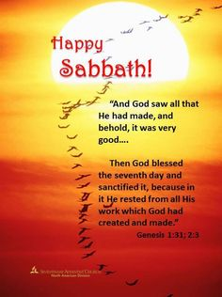

Adventism
Doctrines
Lifestyle

Slide 7

Adventism is a World View
Acknowledges the Bible as the foundational authority in lifestyle and thinking

Slide 8
Adventist World View
Impacts:
View of God
The Bible
Doctrine
Nature of Truth
The Future
Self Concept and Purpose
Understanding of the world, origins, the future
Every aspect of our lives including our intellect

Slide 9
Reason for Existence of Adventist Schools
To teach students to think Biblically
rather than humanistically or secularly
Notes:
That is why we send our children to Seventh-day Adventist schools

Slide 10
Reason for Existence of Adventist Schools
If that is not our purpose in teaching, we should be honest and teach in the public system
If our children do not leave Adventist schools with a Biblical world view, we should send them to secular institutions

Slide 11
Objections
Biblical world view thinking will turn Adventist schools into Bible Colleges
A text for every aspect of a subject – the Bible was not meant to be used that way

Slide 12
Bible College—Negative Connotations
Negative connotations should not impact our dedication to Biblical world view thinking
We take the Bible seriously where it makes a specific point, but it does not address every topic, and
Understand our disciplines within a Biblical worldview as contrasted with alternate views
Notes:
Rather than postmodernism, empiracalism, rationalism, pragmatism, existentialism, Neo-Platonism. Etc.

Slide 13
The Biblical World View and Its Alternatives
The Garden of Eden—without God’s self revelation
Our world without the Bible to give meaning to life
Death of a loved one without hope for the future
Contrast the Biblical world view with other contemporary world views

Slide 14
Biblical Illustrations of World view
Eve
The flood
Kadish-Barnia
Rejection of Christ
The temptation of Christ
Early church
Reformation

Slide 15
God and History
The Bible simply assumes the existence of God.
God is in action when He is first introduced—”In the beginning God created”
God is the God of history
Notes:
He sets history in motion, He is in engaged in history as its sovereign, He is not caught in the web of history, He is its master.

Slide 16
God and History
Biblical
Humanistic
God is the originator of and a causative factor in history
  Created
  Set up/took down kingdoms
  Delivered His people
  Was in Christ reconciling the world to Himself
  Will come again
If God exists, He is caught in the flow of history; history is His master; He is to be judged by history; history is driven by cause and effect
Or, if He does not exist, everything happens as a result of a closed continuum of cause and effect

Slide 17
God and History
Biblical
Humanistic
History has meaning because it was initiated by God and He is guiding it to His culmination in the restoration of our fellowship with Him in the New Earth
God interacts with us in history
Historical events are random and purposeless
We exist in a universe with nothing out there

Slide 18
God’s Action
Biblical
Humanistic
God was and is active in:
  Creation
  Sustaining creation
  The Exodus
  The incarnation
  The resurrection
  The second coming
  The new earth
  In our everyday, personal lives
These events never happened
Or explained by closed system of cause and effect with no divine intervention
Notes:
There is a spirit lurking behind every leaf

Slide 19
God is Personal
Biblical
Humanistic
Created for fellowship
  Sabbath for fellowship
  Saved His people from Egypt
  Was in Christ reconciling the world to Himself
  Will come for us
  Will eradicate sin which separates from Him
  We know God because He has revealed Himself in Jesus Christ and the Bible
God does not exist
We don’t know if God exists
God is a distant being who does not interact with us
God interacts in some mystical way – we know Him because people have recorded their experiences with Him
Notes:
There is a spirit lurking behind every leaf

Slide 20
Biblical Revelation
God reveals Himself and the nature of the world He created
Biblical
Humanistic
The Bible is the divinely inspired Word of God, communicated in history through God’s chosen prophets under the guidance of the Holy Spirit
The Bible came by the will of God
The Bible is simply a human book which captures the genius and spirituality of the human spirit
The Bible came by the will of man

Slide 21
Biblical Revelation
God reveals Himself and the nature of the world He created
Biblical
Humanistic
Under the Holy Spirit, the Bible is its own interpreter
We can understand God, our world, and how to live because of the Bible
God’s revelation in nature is partial and subject to misunderstanding, and can be understood only from the perspective of the Revealed Word
The Bible is interpreted as is any other book, story, narrative, etc
We do not need God our father looking over our shoulder
Nature is all that we have

Slide 22
Creation
Biblical
Humanistic
The universe and our world were created by God with purpose
God created life on this planet a short time ago
The universe and this world came into existence by chance
Life was formed by accident billions of years ago
Life gradually evolved under the guidance of God

Slide 23
Creation
Biblical
Humanistic
We were created in God’s image
God is our father; we are His children
God saw that the creation was good
We were created by tooth and claw by random purposeless mutations
We are beholden to no one besides ourselves
There is no intrinsic moral significance to nature other than what we give it

Slide 24
Human Nature
Biblical
Humanistic
Created in the image of God
Our God-given minds are used in harmony with God’s word
We are the result of evolutionary forces
Our creation took place over missions of years, we descended from the animal kingdom
Our minds are absolutely autonomous. We do not need God our Father

Slide 25
Human Nature
Biblical
Humanistic
We were created for fellowship with God and each other
We are not our own; Marriage between male and female is part of God’s plan
Survival of the fittest determines our lives
We are our own; we can use our bodies as we like

Slide 26
Human Nature
Biblical
Humanistic
Our goal is restoration to the image of God
We can feed our minds and our lives however we desire to fulfill our own pleasure and aspirations

Slide 27
Human Nature
Biblical
Humanistic
We were created a unity of mind, body, and soul; we cease to exist at death
We are not a unity; there is a soul that can be treated separately from the body (as in theistic evolution) and exists independently of the body

Slide 28
Human Nature
Biblical
Humanistic
Sin is a moral choice, an action or thought that is contrary to who God is
Sin has separated us from God and one another
Sin is the result of a brain disorder or biological malfunction, not a transgression of God’s law or character

Slide 29
Sin
Biblical
Humanistic
Sin is disobedience to the Word of God or the desire to establish one’s self as equal to or God autonomous from Him
Lack of knowledge is the root of all evil—it is ignorance, irrationality or misinformation
There is no such thing as sin in the Biblical sense

Slide 30
Salvation
Biblical
Humanistic
Salvation is possible only through grace by faith in the atoning sacrifice of Jesus Christ
Humanity will solve the problem of evil in the world through
  political structures,
  management of the process of evolution
  by science, technology, economics and education

Slide 31
Salvation
Biblical
Humanistic
Although human disciples are useful when used in the context of God’s Word, humanity cannot pull itself up by its boot straps. Salvation is in and through God--not genius, human effort, nor will
Individual human salvation results from the right use of science, psychology, sociology, medicine, politics, etc.

Slide 32
Salvation
Biblical
Humanistic
The kingdom of God – heaven on earth - will be established by God Himself
God, as the agent of history will bring about heaven on earth
Human progress and achievement will bring about the kingdom of God on earth
Humankind, as the agent of history will bring about heaven on earth

Slide 33
Freedom
Biblical
Humanistic
Christ sets us free. Our freedom is not independent of God, but enables us by God’s grace to live in freedom from sin
The truth (Jesus Christ and His Word) will set us free
We are absolutely autonomous from any restraints from God or the universe
We are free to determine the truth

Slide 34
Truth
Biblical
Humanistic
Truth--the ability to understand the nature of things--comes from God, communicated through His Word under the Holy Spirit
Truth is an independent principle in the universe by which everything including God is measured
Or, as with post modernism, there is no certain truth. Truth is truth for me.

Slide 35
Faith
Biblical
Humanistic
Faith is itself the evidence, faith comes by hearing the Word of God under the transforming power of the Holy Spirit
Faith is based upon “rational or empirical evidence” that is integrated and interpreted so as to make a projection about the nature of things

Slide 36
Christ
The Way, the Truth, and the Life
Biblical
Humanistic
In the beginning was the Word, and the Word was with God, and the Word was God. He was in the beginning with God. All things were made through Him, and without him nothing was made that was made.” Jn 1:1-3
The truth, if is exists at all, is not revealed in Christ or His Word; it is independent of God and is used to judge His Word, if indeed he revealed Himself in the Bible at all
Notes:
Platonism – the logos – the rational structure of the universe from which truth emanates.
Christ is the logos, not some ethereal philosophical idea.

Slide 37
Christ
The Way, the Truth, and the Life
Biblical
Humanistic
Christ is the light of the world
Christ is the way, the truth, and the life
Human reason, experience or existence is the light of the world

Slide 38
The Great Controversy
The Great Controversy theme, our relation to the world of God is central to scripture and the book Great Controversy
Not between two principles, but between two individuals
The Issue – our relationship to the Word of God
  Satan
  Adam and Eve
  Cain and Able
  Antediluvians & rejection of Noah
  Deliverance from Egypt

Slide 39
The Great Controversy
  Kadesh Barnea – No God in His right mind would send His people to such slaughter
  Babylonian Captivity
  Christ in the Wilderness and on the Cross
  Rejection of the Messiah
  The Heavenly Sanctuary
  The Second Coming
  The Millennium
  The resolution of the sin problem by the establishment of the new earth where sin will dwell no more

Slide 40
The Great Controversy
The Great Controversy is not just cosmic – it includes each one of us
  Will we listen to God’s Word, or will we substitute our own word or that of the world around us?
  Will we teach our students to love the Word of God and accept it as the guide to all of their lives including their intellectual faculties, or will we teach them to think in harmony with the contemporary world views rather than the world view of scripture?

Slide 41
The Great Controversy
“There will be a people upon the earth who will accept the Bible and the Bible only as the standard of all doctrines and the basis of all reforms. The opinions of learned men, the deductions of science, the creeds or decisions of ecclesiastical councils. . . , the voice of the majority, not one nor all of these should be regarded as evidence for or against any point of religious faith.” GC 595

Slide 42
The Great Controversy
Science
History
Psychology
Politics
Sociology
Philosophy
Empiricism
Notes:
The world in which we live gives power to science, history, psychology, politics, sociology, and many other human disciplines. It relies upon the wisdom of philosophy and the dictates of empiricism. It builds “designer gods” that please our culture and are in harmony with our world view

Slide 43

The Great Controversy
Science
History
Psychology
Politics
Sociology
Philosophy
Empiricism
Notes:
By contrast, scripture affirms the power of the Word of God to bring us to knowledge of the true God and, under the Holy Spirit, to restore us to a right relationship with Him and a true understanding of our world

Slide 44
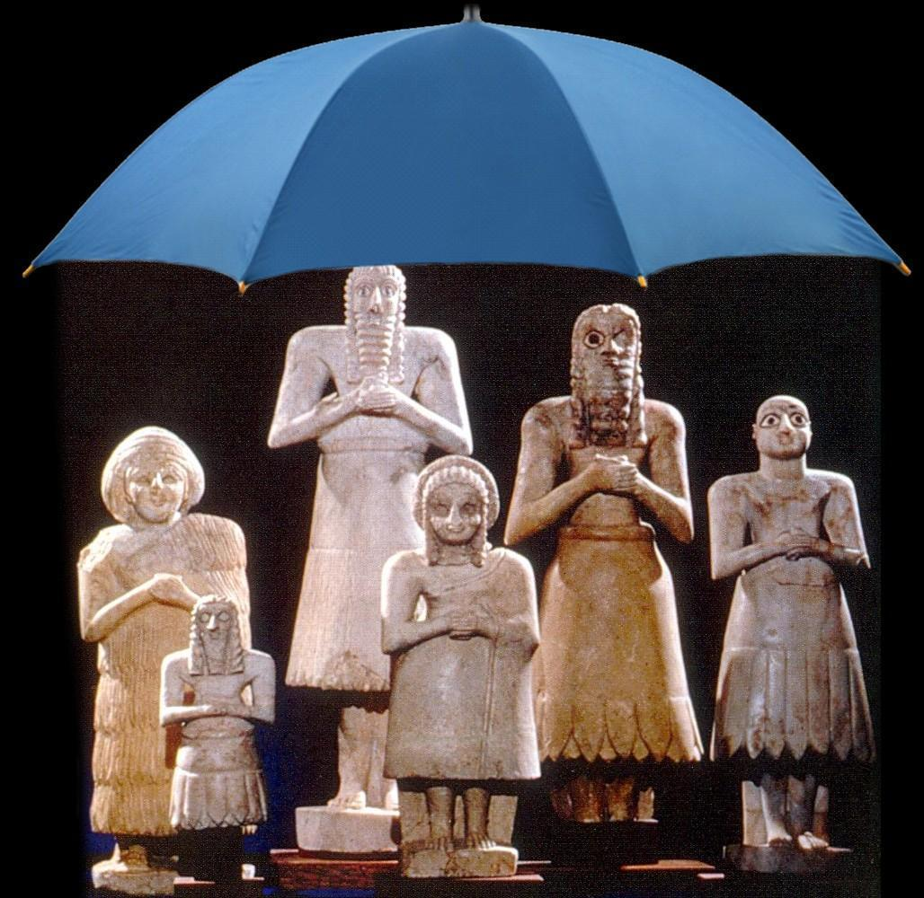

The Great Controversy
Choose you this day whom you will serve
Notes:
Choose you this day whether you will follow
the Word of God or
the many world views of our culture

